Slide 1
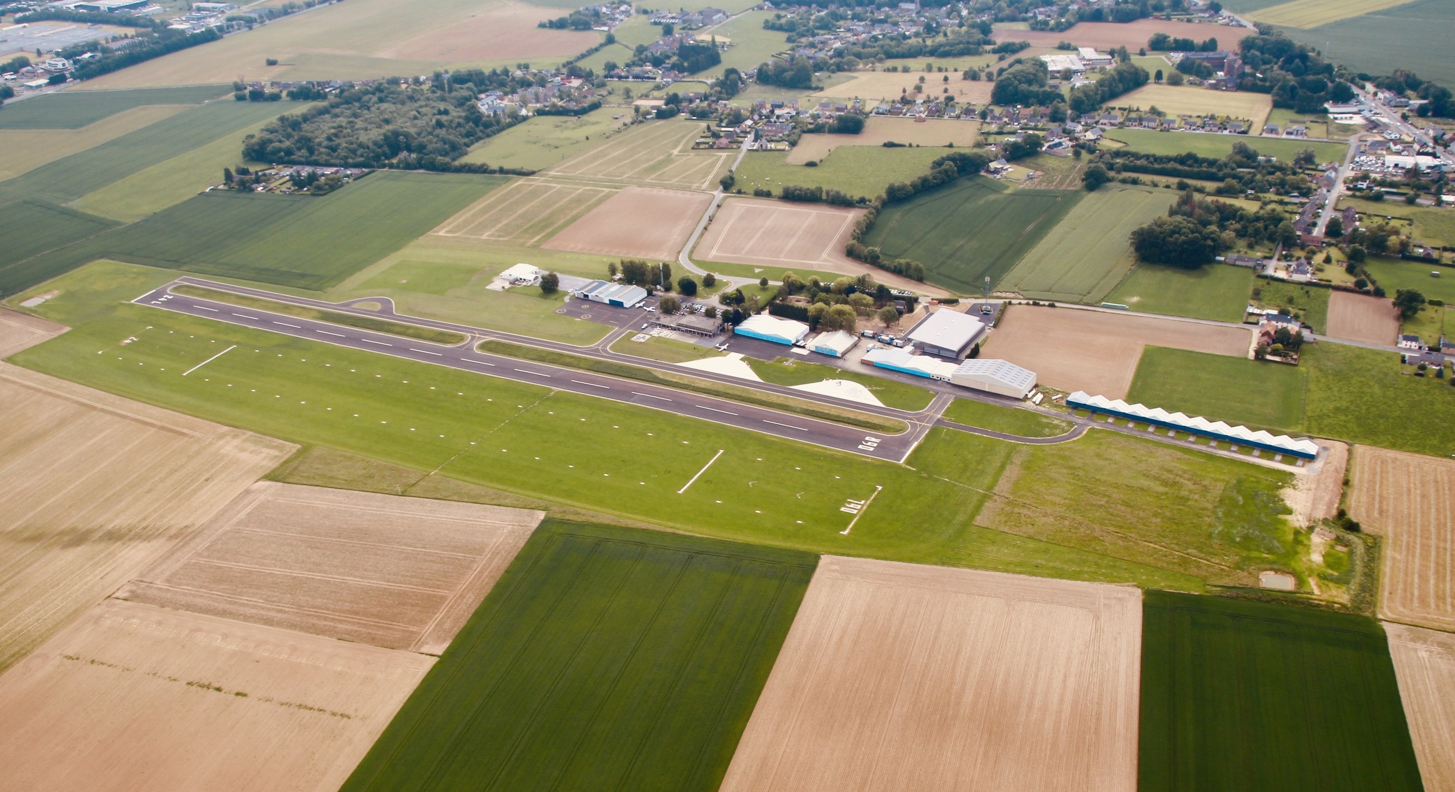
Identify Components of an Aerodrome
M160.01

Slide 2
MAIN TOPICS TO BE COVERED
THE DIFFERENCE BETWEEN AN AERODROME AND AN AIRPORT
IDENTIFY SEVERAL COMPONENTS OF AN AERODROME
CLASS ACTIVITY – GOOGLE QUIZ

Slide 3
DIFFERENCE BETWEEN AN AERODROME AND AN AIRPORT
AERODROME
AIRPORT
An aerodrome is any area of land or water (including frozen areas) designed for the arrival, departure, movement and or servicing of aircraft

Slide 4
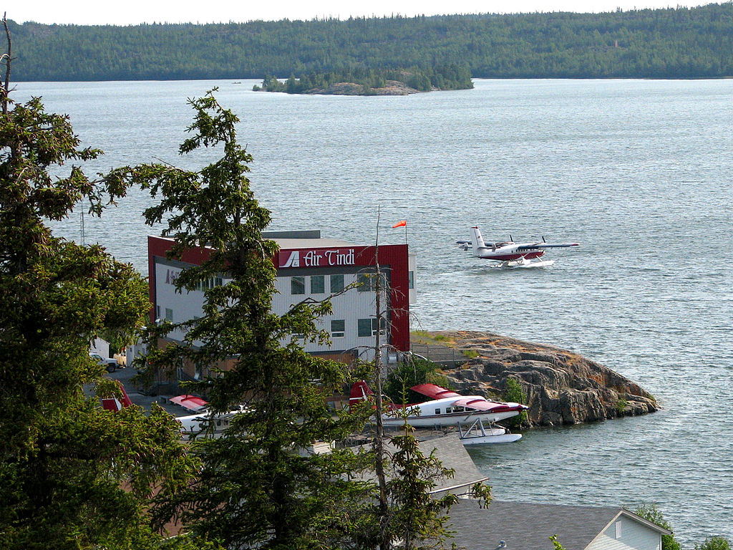
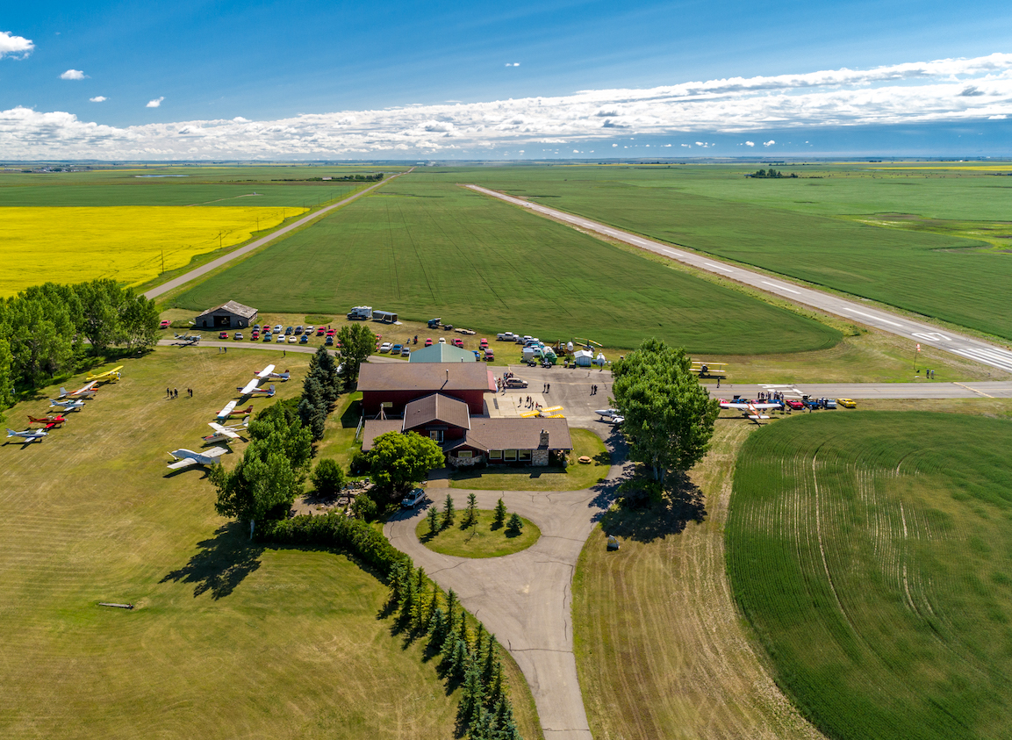
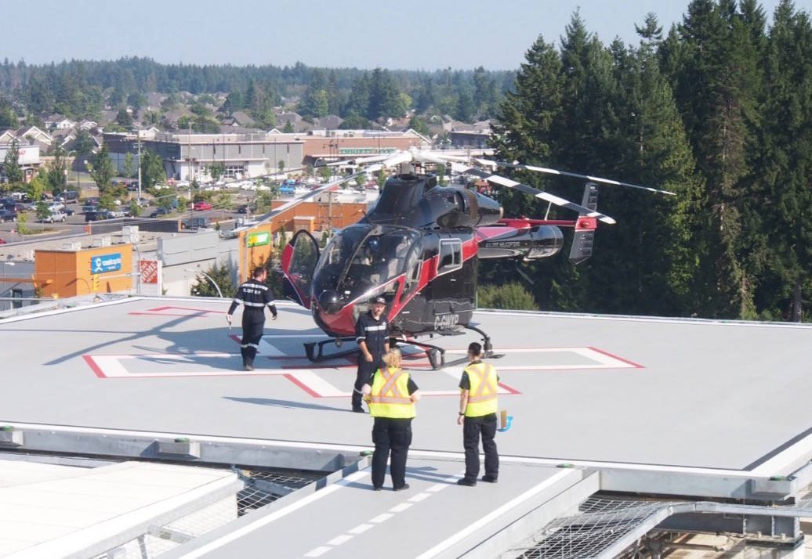
TYPES OF AERODROMES
WATER
PRIVATE
HELIPORTS
YELLOWKNIFE WATER AERODROME
ESTATE HOME WITH RUNWAY ON RESIDENCE
ROOFTOP HELIPORT AT COMOX VALLEY HOSPITAL

Slide 5
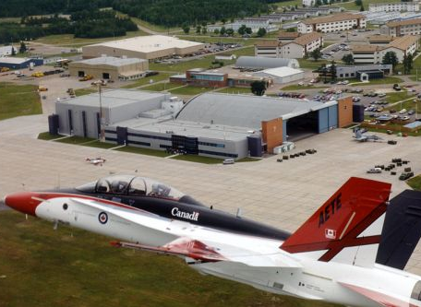
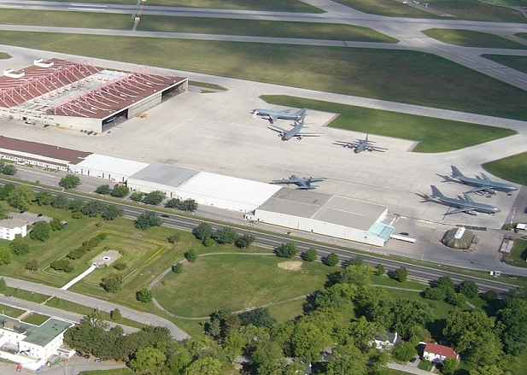
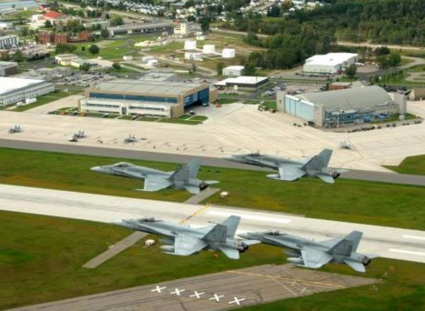
TYPES OF AERODROMES
MILITARY AERODROMES
SOME EXAMPLES INCLUDE:
CFB COLD LAKE ALBERTA
CFB TRENTON ONTARIO
CFB BAGOTVILLE QUEBEC

Slide 6
DIFFERENCE BETWEEN AN AERODROME AND AN AIRPORT
AERODROME
AIRPORT
An aerodrome is any area of land or water (including frozen areas) designed for the arrival, departure, movement and or servicing of aircraft.
An aerodrome for which, under Part III of the Canadian Aviation Regulations, an airport certificate has been issued by the Minister of Transport Canada.
Aerodromes must be certified when:
They are located in a built-up area of a city or town;
They are used by an air carrier as their main operating base or for scheduled passenger carrying service; or
It is deemed to be in the public interest.
There are three categories of aerodromes (based on level of safety): aerodromes, registered aerodromes and certified aerodromes.

Slide 7
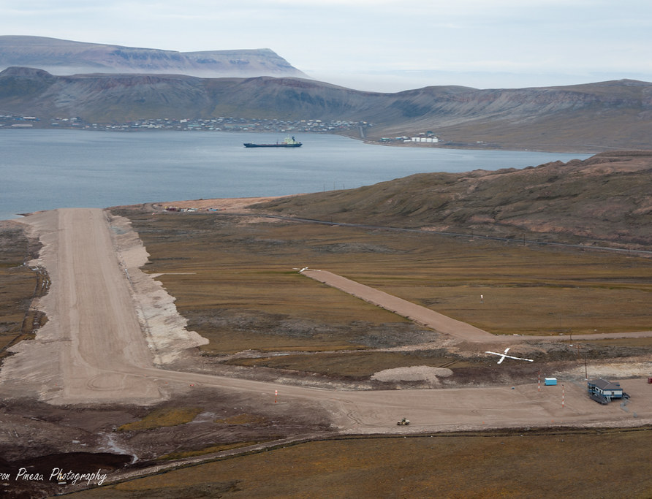
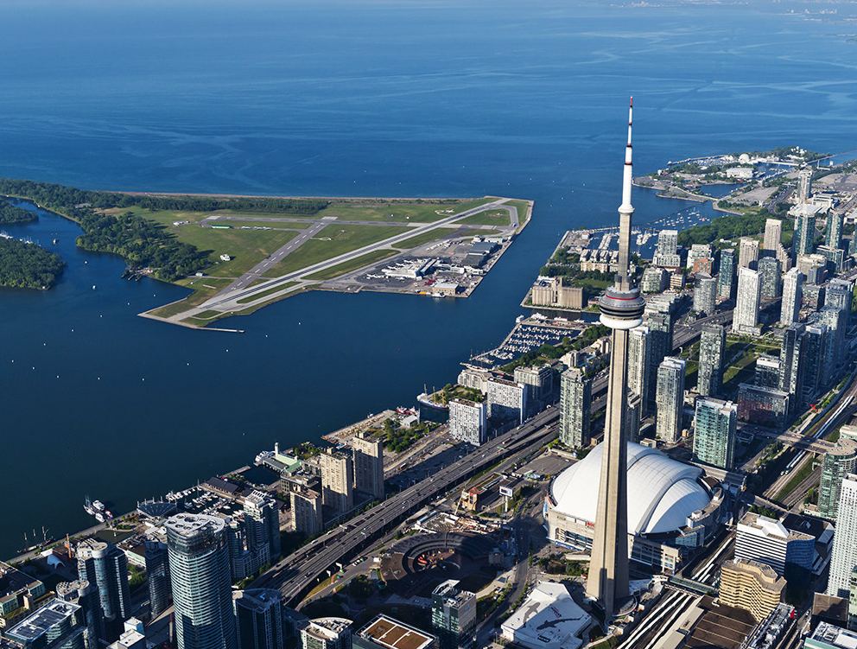
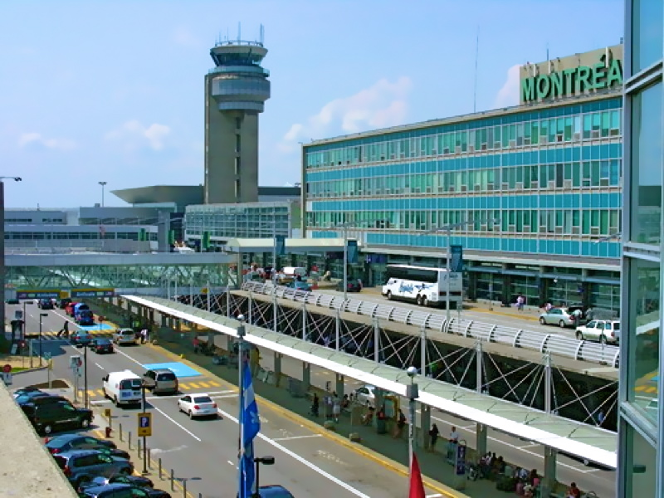
CLASSES OF AIRPORTS
SMALL, REMOTE AND ARCTIC AIRPORTS
LOCAL AND REGIONAL AIRPORTS
AIRPORTS IN THE NATIONAL AIRPORT SYSTEM
ARCTIC BAY AIRPORT ARCTIC BAY, NUNAVUT
BILLY BISHOP TORONTO CITY AIRPORT TORONTO, ON
MONTREAL-PIERRE ELLIOTT TRUDEAU INTERNATIONAL AIRPORT MONTREAL, QC

Slide 8
LET US REVIEW

Slide 9
MAIN TOPICS TO BE COVERED
THE DIFFERENCE BETWEEN AN AERODROME AND AN AIRPORT
IDENTIFY COMPONENTS OF AN AERODROME
CLASS ACTIVITY – GOOGLE QUIZ


Slide 10
COMPONENTS OF AN AERODROME

Slide 11
HANGAR
USED TO PARK AIRCRAFT TO PROTECT THEM FROM THE WEATHER
CAN BE USED AS A PLACE TO DO MAINTENANCE WORK

Slide 12
COMPONENTS OF AN AERODROME

Slide 13
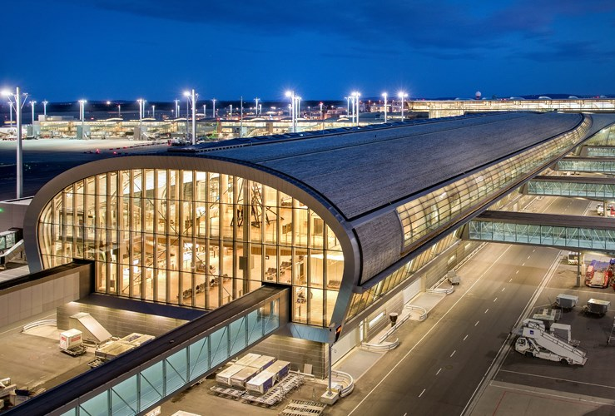
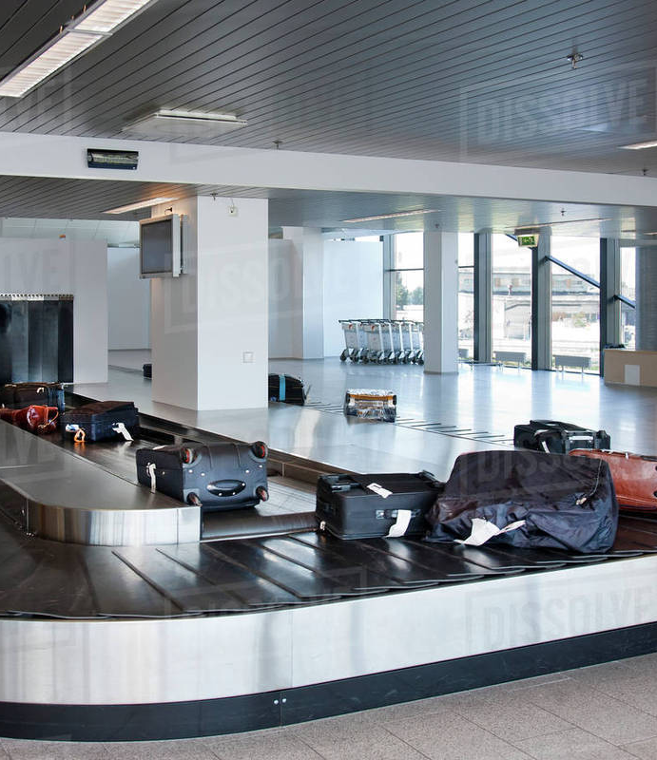
TERMINAL
USED FOR PASSENGERS ARRIVING OR DEPARTING ON FLIGHTS.
USED TO HANDLE BAGGAGE AND CARGO

Slide 14
COMPONENTS OF AN AERODROME

Slide 15
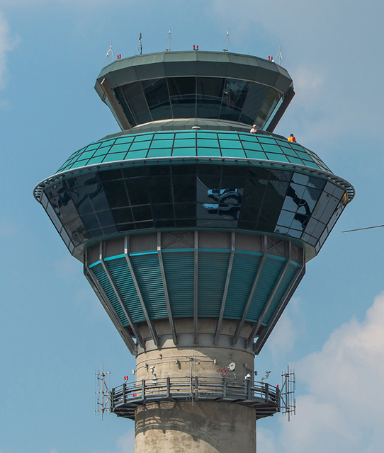
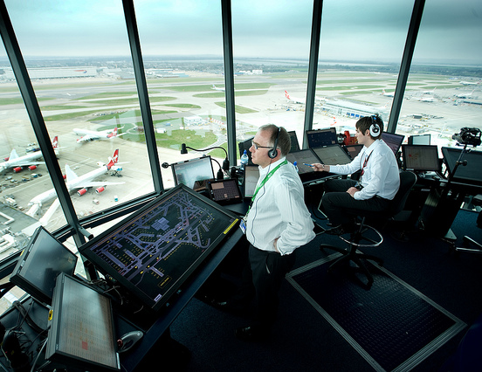
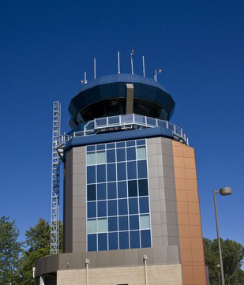
CONTROL TOWER
USED BY AIR TRAFFIC CONTROLLERS TO COORDINATE MOVEMENT OF AIRCRAFT IN THE AIR AND ON THE GROUND AND OTHER VEHICLES ON THE AERODROME

Slide 16
COMPONENTS OF AN AERODROME

Slide 17
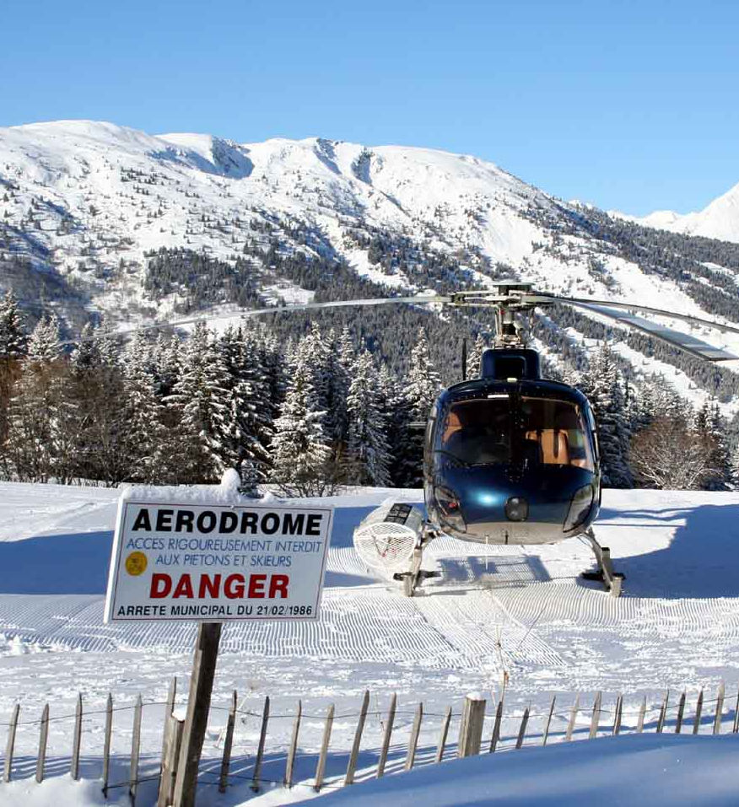
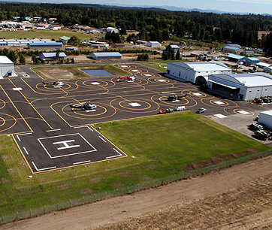
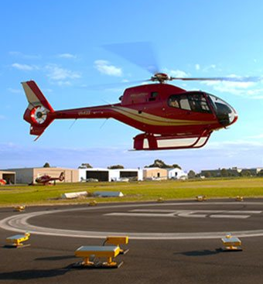
HELIPAD
USED BY FOR TAKE-OFFS AND LANDINGS FOR HELICOPTERS

Slide 18
COMPONENTS OF AN AERODROME

Slide 19
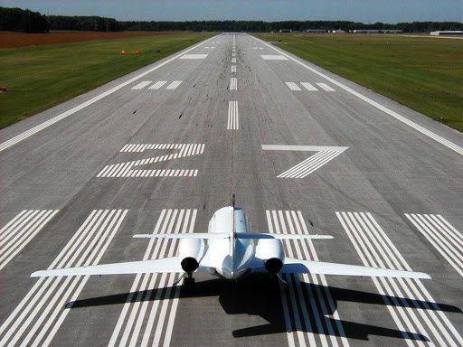
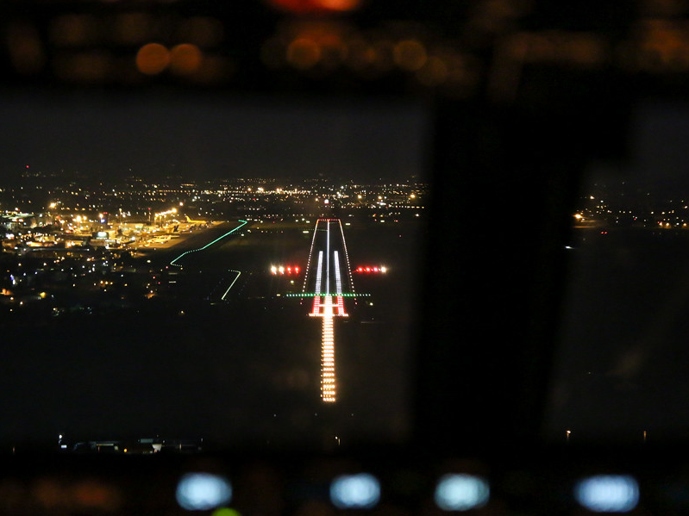
RUNWAY
USED FOR TAKE-OFFS AND LANDINGS FOR AIRPLANES
DESIGNATED BY NUMBERS WITH WHITE LINES/LIGHTS ON ITS SIDES

Slide 20
COMPONENTS OF AN AERODROME

Slide 21
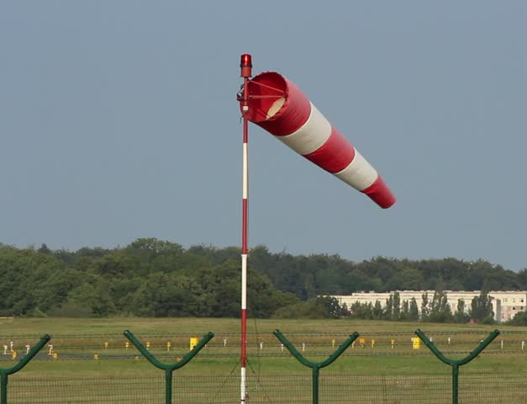
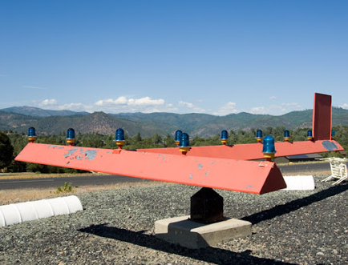
WIND SOCK / WIND T
USED BY PILOTS TO DETERMINE THE DIRECTION AND SPEED OF THE WIND

Slide 22
COMPONENTS OF AN AERODROME
Wind Sock / Wind T
Used by pilots to determine wind speed

Slide 23
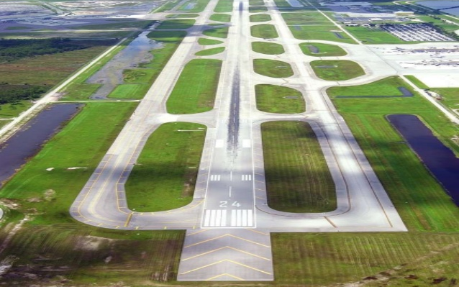
TAXI WAY
USED BY AIRCRAFT TO MANOEUVRE AROUND THE AERODROME BETWEEN APRONS AND RUNWAYS.
DESIGNATED BY LETTERS & MAY BE LIT WITH BLUE LIGHTS ON SIDES

Slide 24
COMPONENTS OF AN AERODROME
Wind Sock / Wind T
Used by pilots to determine wind speed

Slide 25
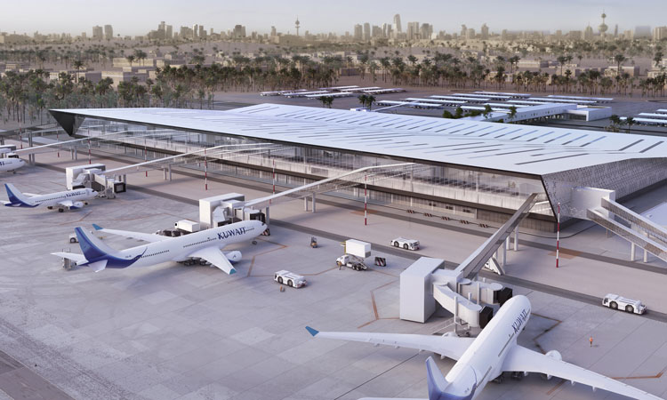
APRON / RAMP
INTENDED TO ACCOMMODATE THE LOADING AND UNLOADING OF PASSENGERS AND CARGO. IT IS ALSO THE AREA USED FOR REFUELLING, SERVICING AND PARKING OF AIRCRAFT

Slide 26
COMPONENTS OF AN AERODROME
Wind Sock / Wind T
Used by pilots to determine wind speed and direction

Slide 27
QUESTIONS?

Slide 28
MAIN TOPICS TO BE COVERED
THE DIFFERENCE BETWEEN AN AERODROME AND AN AIRPORT
IDENTIFY COMPONENTS OF AN AERODROME
CLASS ACTIVITY – GOOGLE QUIZ



Slide 29
https://forms.gle/wwnQLvfvLPECafSNA

Slide 30
MAIN TOPICS TO BE COVERED
THE DIFFERENCE BETWEEN AN AERODROME AND AN AIRPORT
IDENTIFY COMPONENTS OF AN AERODROME
CLASS ACTIVITY – GOOGLE QUIZ




